Slide 1
Customer Market Analysis
Data Analysis & Interactive Dashboard Project
Sazzadul Islam | DataInsight Portfolio

Slide 2
Project Objective
Segment customers by purchasing behavior to enable targeted marketing campaigns and improve customer retention.

Slide 3
Methodology: Step by Step
1. Data Collection
& Preparation
2. SQL Analysis
3. Python Analysis
(Modeling)
4. Dashboard
Development
→
→
→
Full workflow used to go from raw idea to a working, data-backed dashboard.

Slide 4
Step 1 — Data Collection & Preparation
Synthetic sample dataset (seed=42, reproducible): 50 customers, 249 transactions across product categories with dates and order amounts.
Note: this is a representative sample dataset generated for demonstration purposes, not the full production-scale dataset.

Slide 5
Step 2 — SQL Analysis
Used SQL window functions (NTILE) to score each customer on Recency, Frequency and Monetary value, then combined the three quartile scores into an RFM segment label.
SELECT customer_id,
NTILE(4) OVER (ORDER BY recency_days) AS r_score,
NTILE(4) OVER (ORDER BY frequency) AS f_score,
NTILE(4) OVER (ORDER BY monetary DESC) AS m_score
FROM customer_agg;

Slide 6
Step 3 — Python Analysis
Loaded the RFM scores into pandas, standardized the features, and applied K-Means clustering (scikit-learn) to group customers into behavioral segments.
from sklearn.cluster import KMeans
X = scale(rfm[['recency','frequency','monetary']])
kmeans = KMeans(n_clusters=4, random_state=42).fit(X)
rfm['segment'] = kmeans.labels_

Slide 7
Step 4 — Dashboard Development
Built an interactive HTML/Chart.js dashboard with KPI cards and charts (revenue by segment, top categories, RFM scatter) driven by the aggregated data.

Slide 8
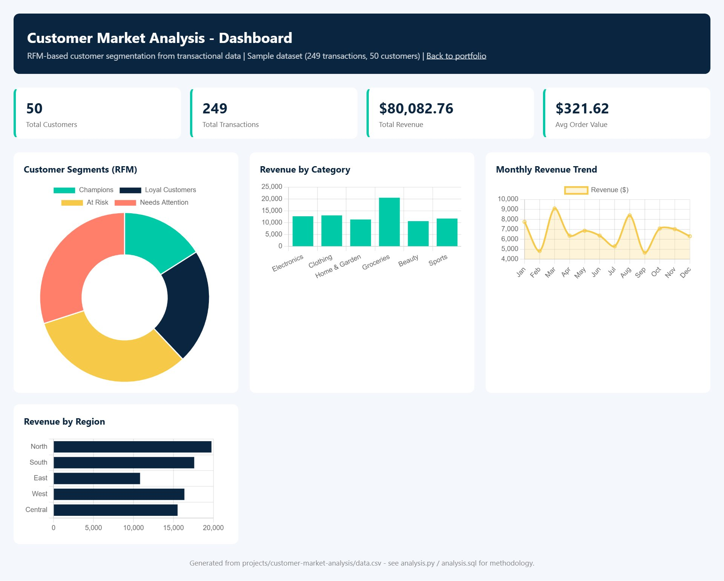
Live Dashboard

Slide 9
Key Results
50
249
Customers
Transactions
$80,082.76
$321.62
Total Revenue
Avg Order Value

Slide 10
Insights & Conclusion
Champions (high value, frequent, recent buyers) drive a disproportionate share of revenue; At-Risk customers represent a clear re-engagement opportunity.
sazzadulislam352.github.io/sazzadul-islam-portfolio

